Slide 1

MYER-BRIGGS PERSONALITY TYPES

Slide 2
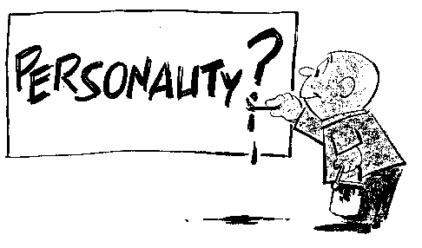

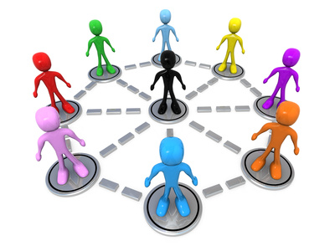
Personality
Personality can be defined as “the complex of characteristics that distinguishes an individual or a nation or group; especially : the totality of an individual’s behavioral and emotional characteristics”.
Understanding personalities is a vital part of being a manager.
People are different and that’s a fact and to better understand how to interact and engage with them it is important to understand what type of personality your dealing with.
Having an understanding of personality and learning styles of individuals in your organization can generate a productive pleasant place to work.
The Myers-Briggs personality test is a tool that a manager can use to define the personality of individuals in the organization.

Slide 3
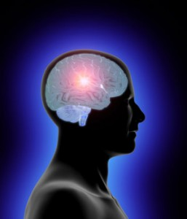
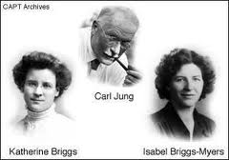
Myers-Briggs
The Myers-Briggs test was developed by a mother/daughter team in the 40’s based of off the lifelong work of Carl Jung.
The test was intended to bring a everyday applications of Jung’s work to the public in order to provide personality matches for social and work environments.
The test was a new interpretation of Jung’s theory and added to it by including how people deal with the outside world.
There have been over 600 dissertations written about the study and 1000’s of articles and books.

Slide 4
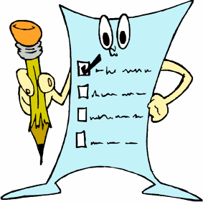
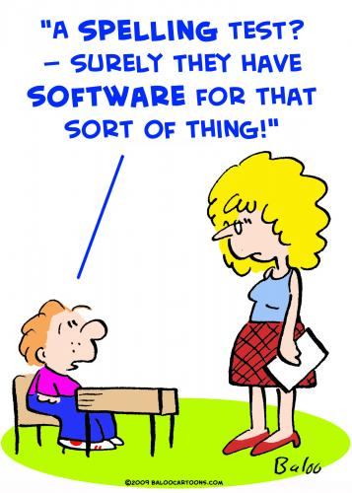
The Test
The test is broken down into four categories.
Favorite World: Do you prefer to focus on the outer world or your own inner world? This is called Extraversion (E) or Introversion (I)
Information: Do you prefer to focus on the basic information you take in or do you prefer to interrupt and add meaning? This is called Sensing (S) or Intuition (N)
Decisions: When making decisions, do you prefer to first look at logic and consistency or first look at the people and special circumstances? This is called Thinking (T) or Feeling (F)
Structure: In dealing with the outside world, do you prefer to get things decided or do you prefer to stay open to new information and options? This is called Judging (J) or Perceiving (P)

Slide 5
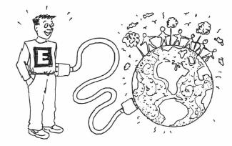
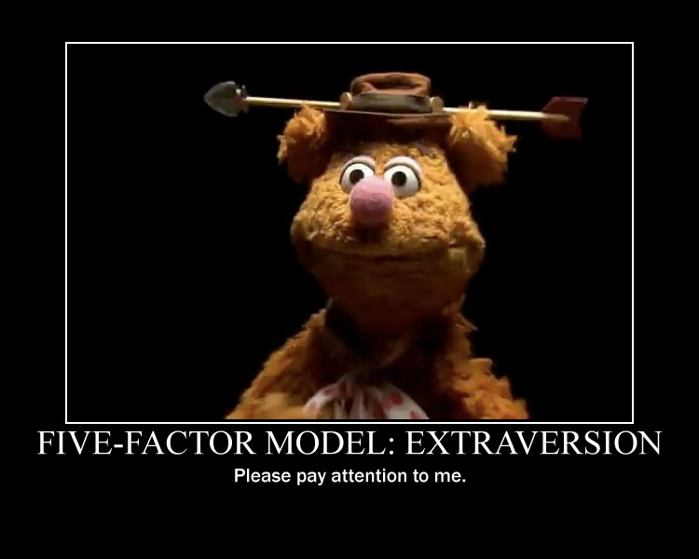
Extraversion ( E )
Act First
Prefers interaction from the outside world.
Motivated by the outside forces and people
Enjoys a wide verity of relationship with several individuals

Slide 6
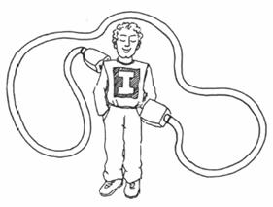
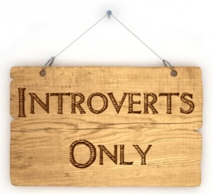
Introversion ( I )
Think and reflect before responding
Needs time alone to recharge
Finds motivation from within, closes mind off from outside world
Prefers one-on-one time in relationships

Slide 7
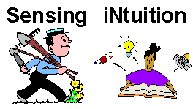

Sensing ( S )
Mental state of mind dwells in the present
Uses common sense to create practical solutions
Vivid memory recall rich in detail
Utilizes past experiences for improvisation
Prefers clear concrete information

Slide 8

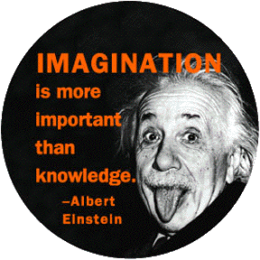
Intuition ( N )
Mentally dwells in the future and future possibilities
Uses imagination and creativity to formulate new solutions
Memory recalls patterns, content, and connections
Comfortable with deciphering fuzzy data

Slide 9

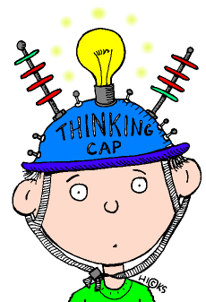
Thinking ( T )
Make decisions based on facts and logic
Notices task and work to be done
Provides objective and critical analysis
Accept conflict as part of human nature in relationships

Slide 10
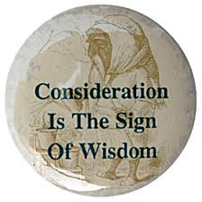
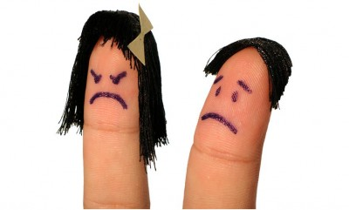
Feeling ( F )
Use personal feeling to make decisions
Sensitive to the needs of others and takes others into consideration
Seeks approval from peers and sides with popular opinion
Becomes unsettled around conflict and disorder

Slide 11


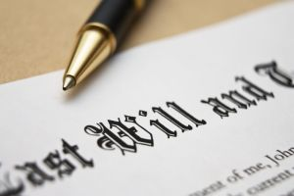
Judging ( J )
Plans details in advance
Focus task at hand and completes meaningful segments before moving on
Works to avoid stress and stays ahead of deadlines
Uses target dates and goals to manage life

Slide 12
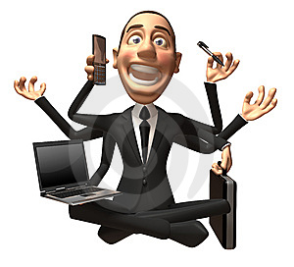

Perceiving ( P )
Moves into action with out a plan
Multitask and mixes work with pleasure
Tolerant of deadlines, dose best work under pressure
Avoids commitments that interfere with flexibility, freedom, and variety

Slide 13
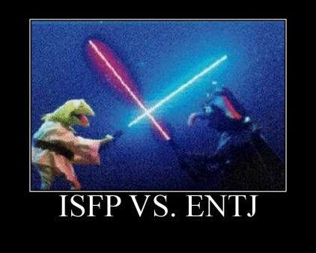
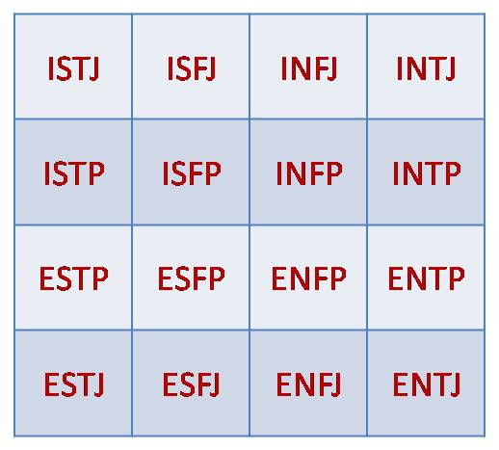
The Code
After taking the test a four letter code is generated based on your answers.
There are 16 possible combinations of letters and each combination defines the individuals personality.
Taking your combination of letters into consideration determines your personality preferences.

Slide 14

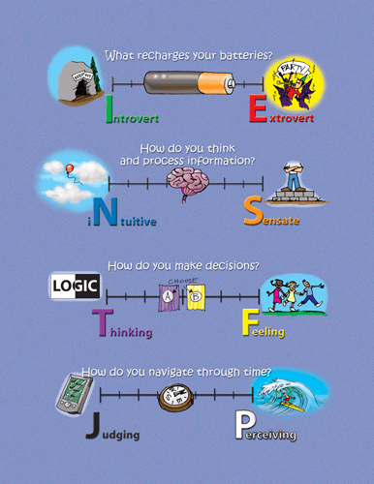
The Code
The Myers-Briggs indicator is a useful tool for managers to utilize in determining the placement of an individual within and organization. By blending the right personality types effective team performance and work place harmony can occur. With the MBTI in a managers tool bag one could tailor a teams design to net the results desired for the appointed task.

Slide 15
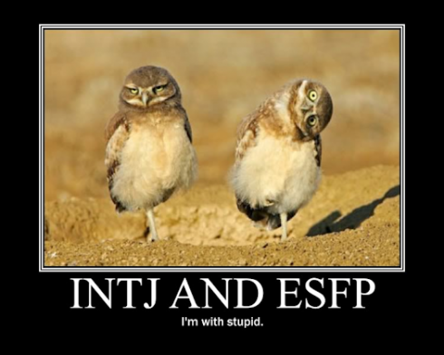

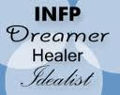

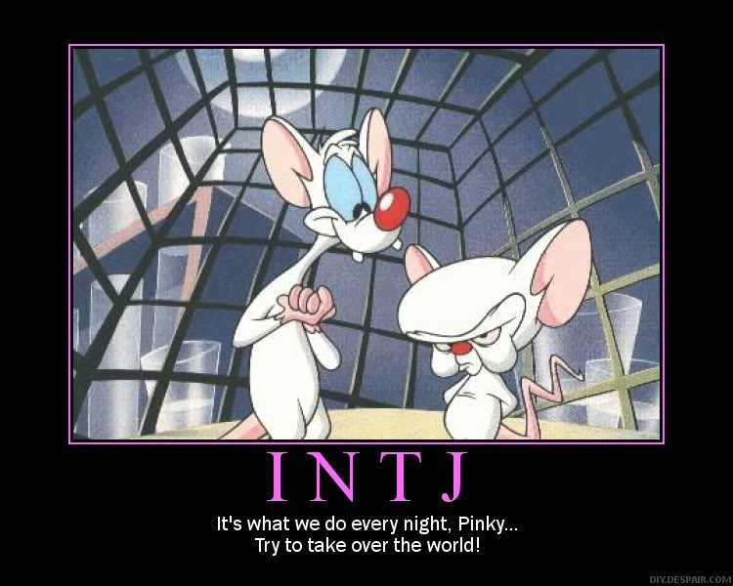
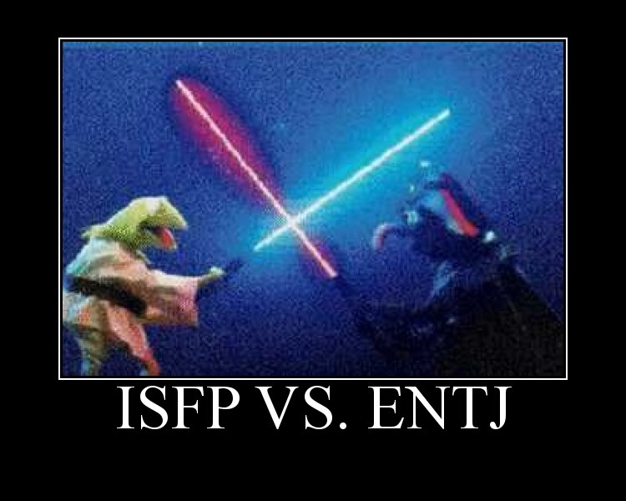
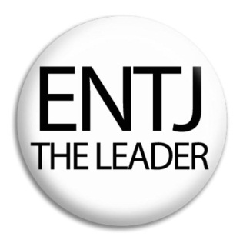
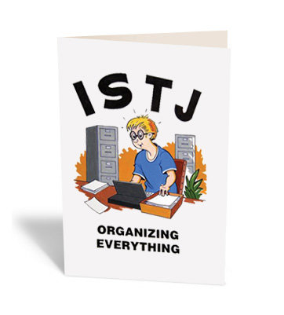
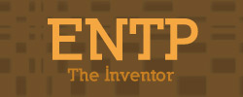
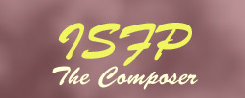
Personality Types

